Slide 1
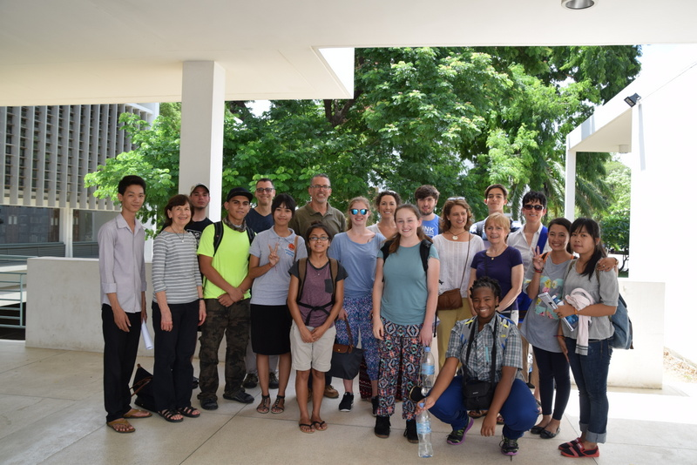
Partnership for Youth: Cambodia
Shaping Sustainable Schools and Communities
Sponsored by the East-West Center & organized by:
Namji Steinemann, Director of the AsiaPacificEd Program for Schools
in partnership with Scarsdale H.S., Furr H.S. & Pacific Buddhist Academy
July 1 – July 15, 2015

Slide 2
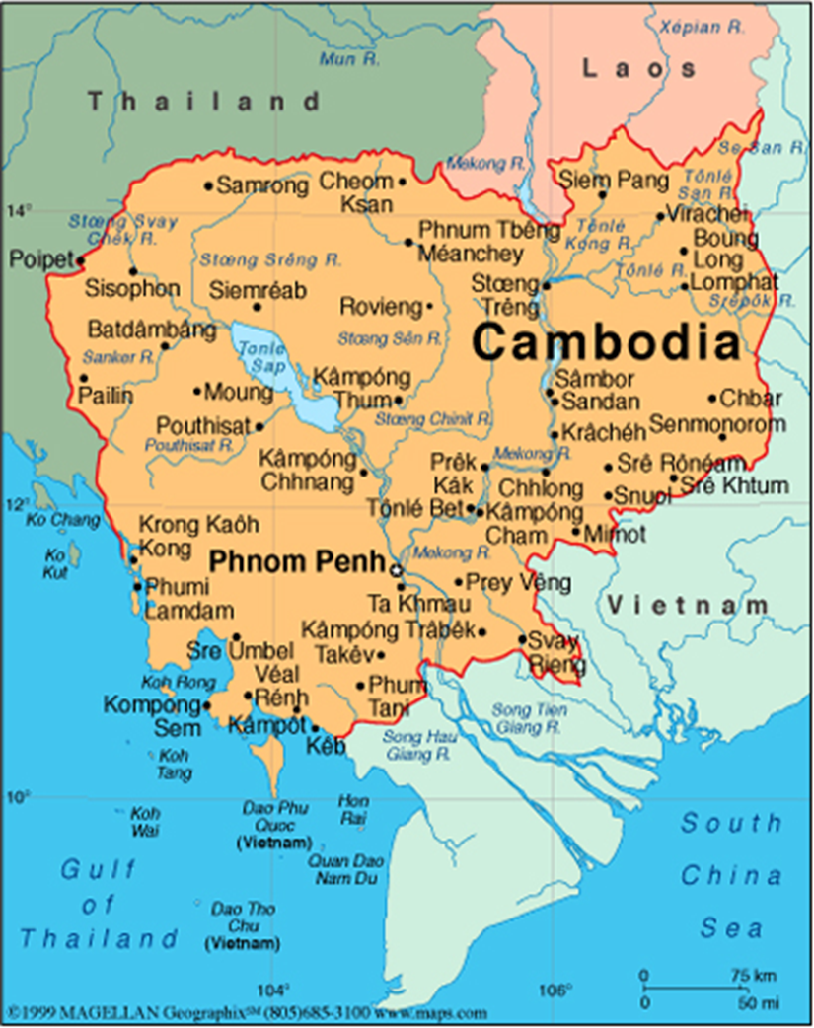
Cambodian Experience
Siem Reap *
*
*
Koh Preah Island,
Mekong River *
Phnom Penh *
*

Slide 3
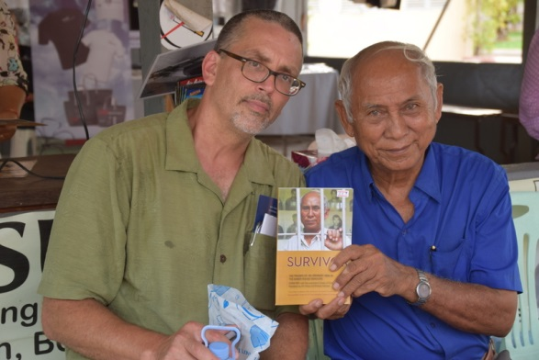
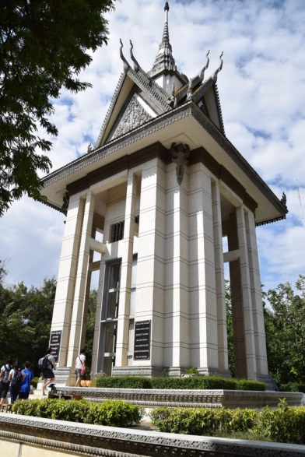
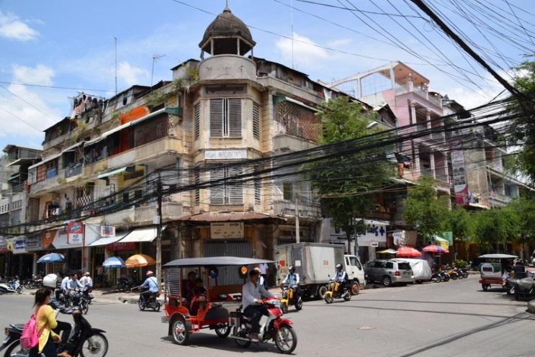
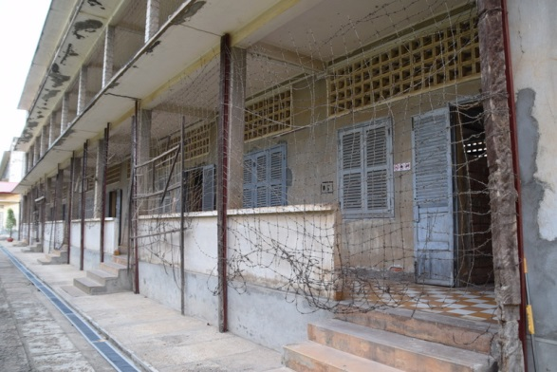
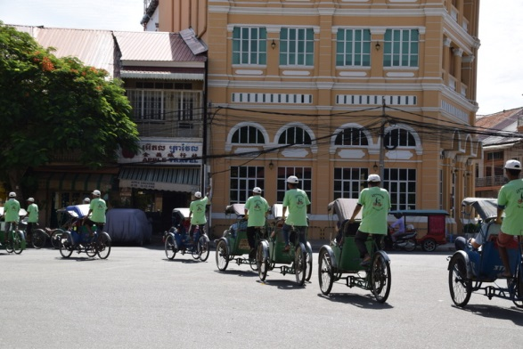
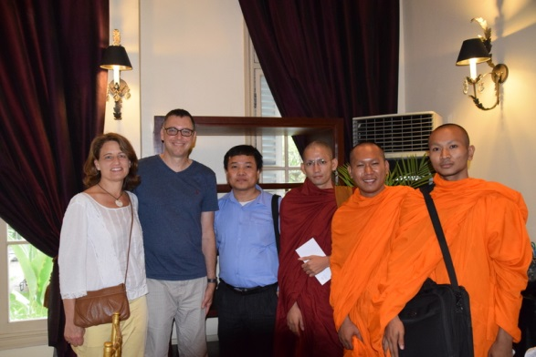
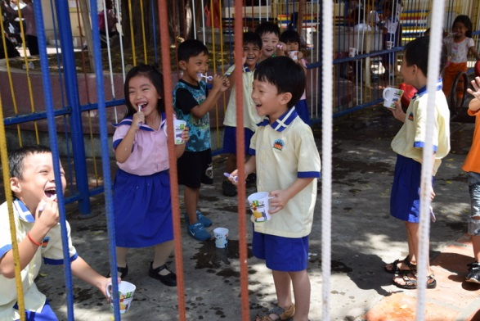
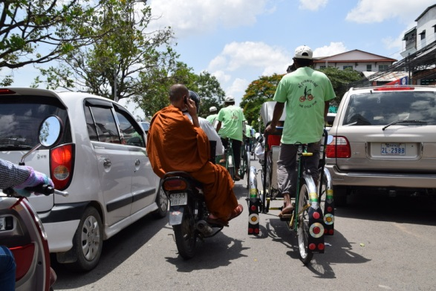
Multi-faceted Phnom Penh . . .

Slide 4
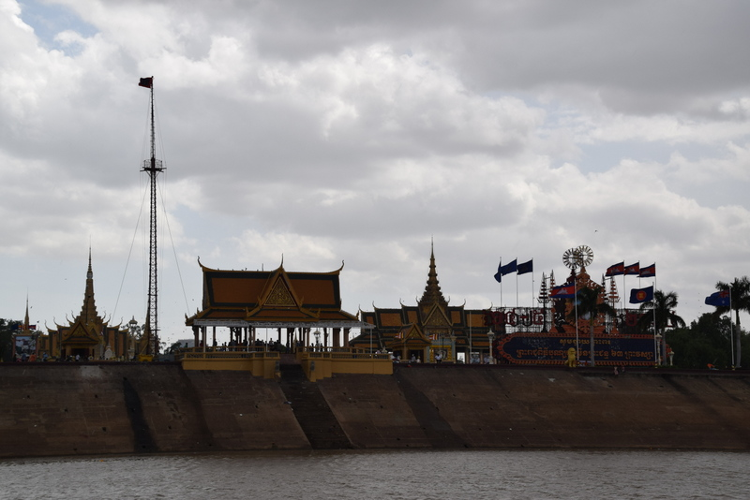
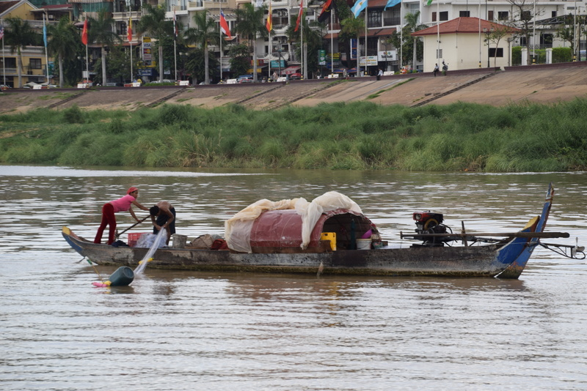
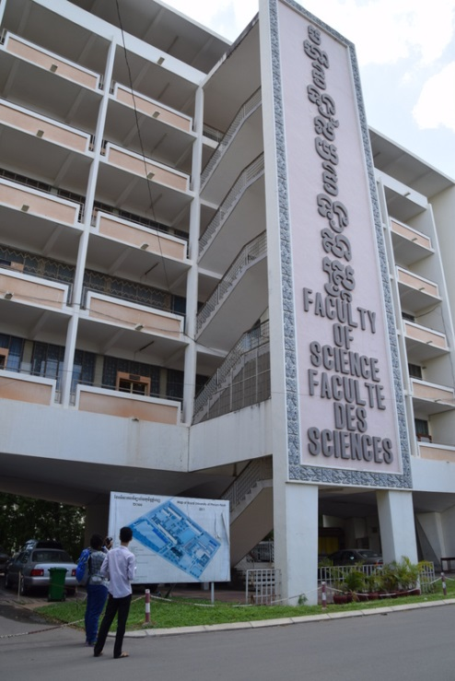
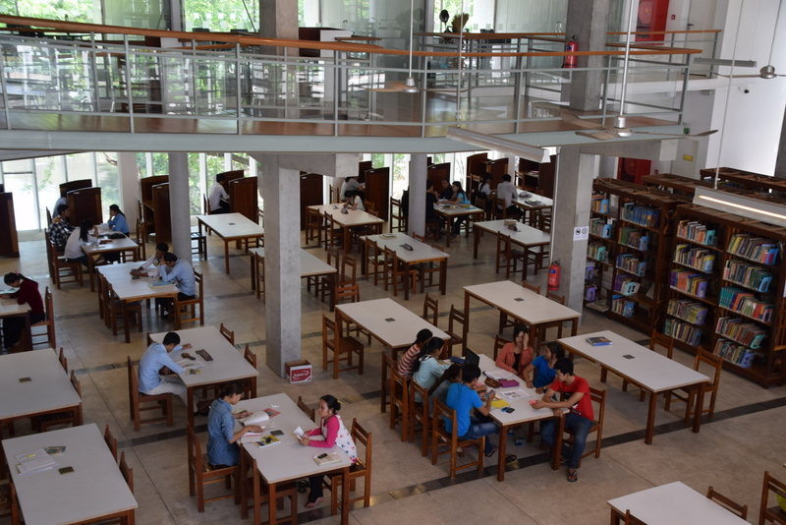
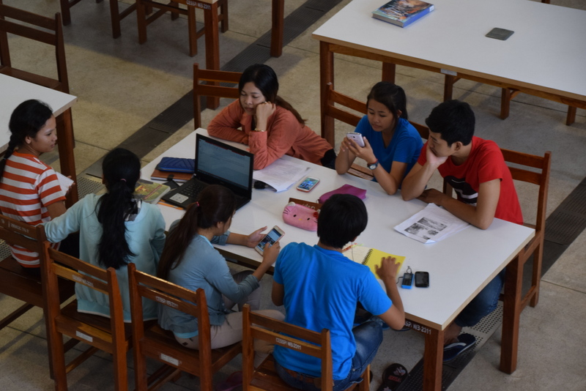
Phnom Penh at the confluence of the Tonle Sap, Mekong & Bassac Rivers
University of Phnom Penh visit . . .

Slide 5
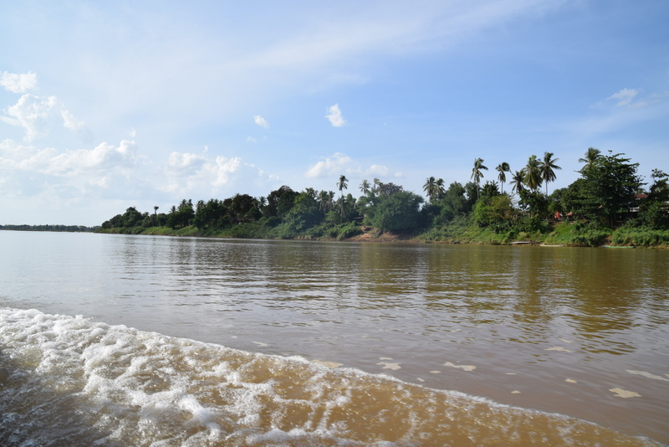
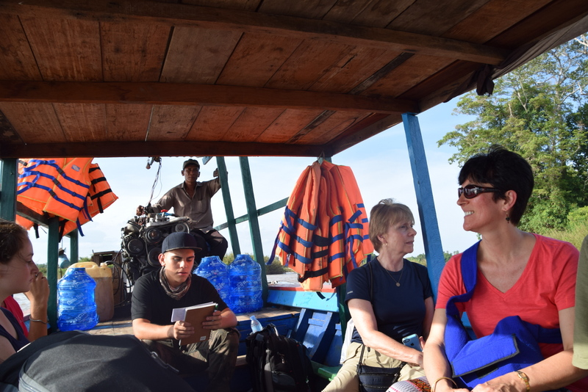
Mekong River on way to Koh Preah Island …

Slide 6
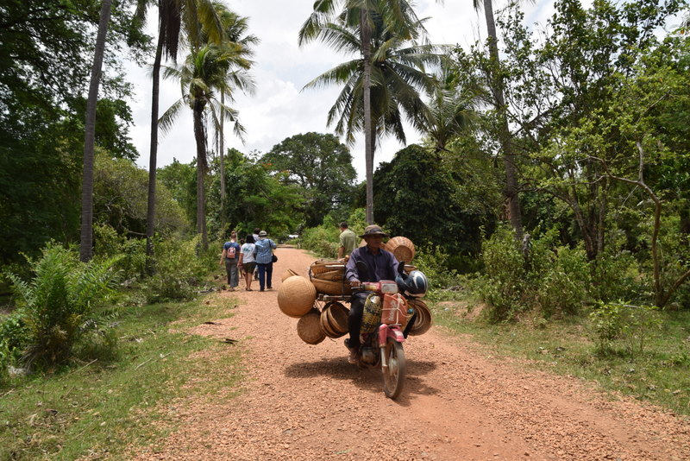
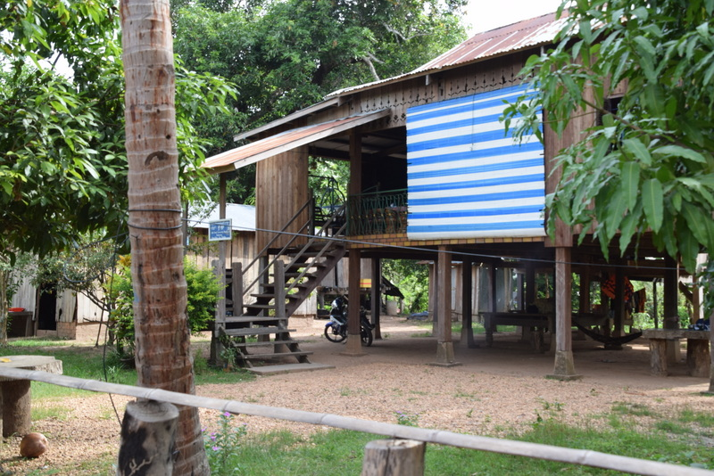
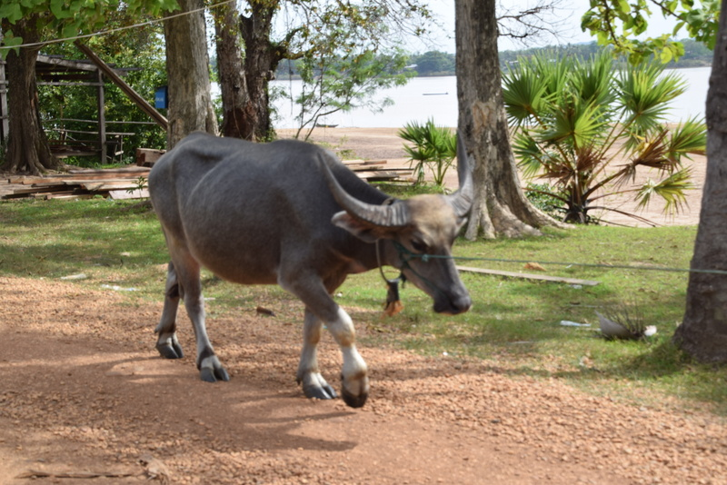
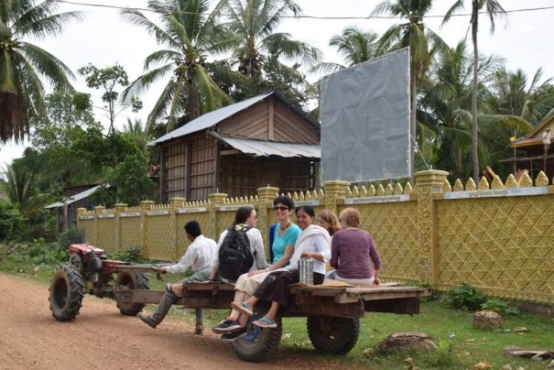
‘Local Pathways’ – Koh Preah Island

Slide 7
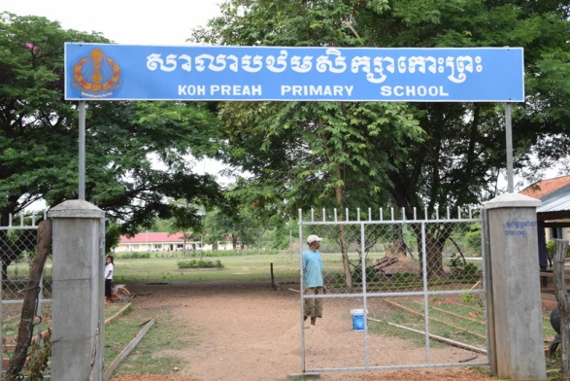
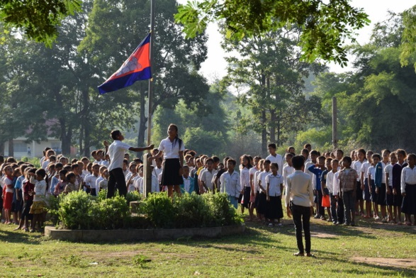
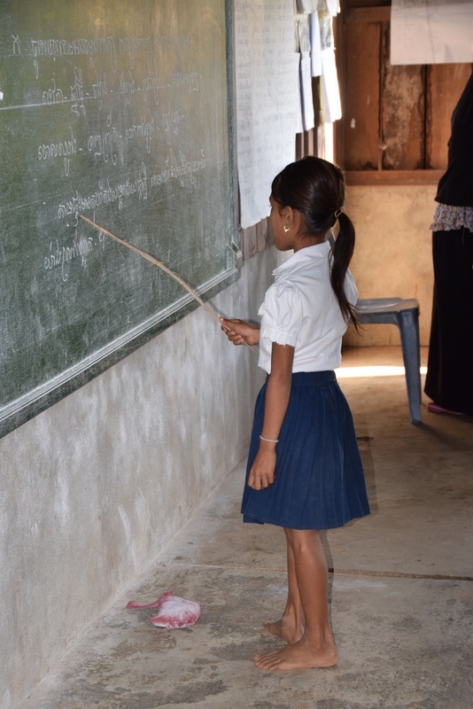
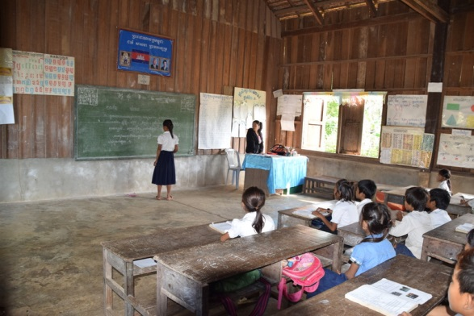

Slide 8
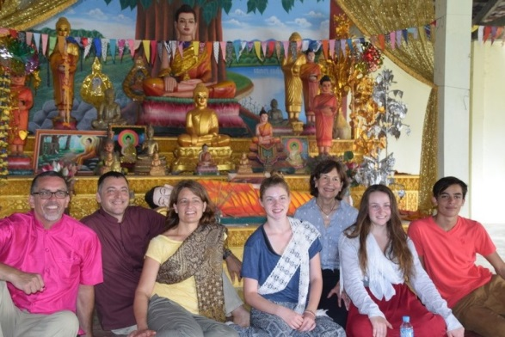
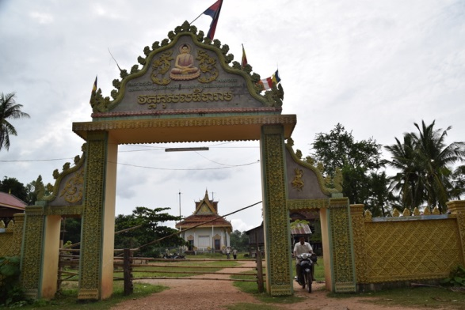
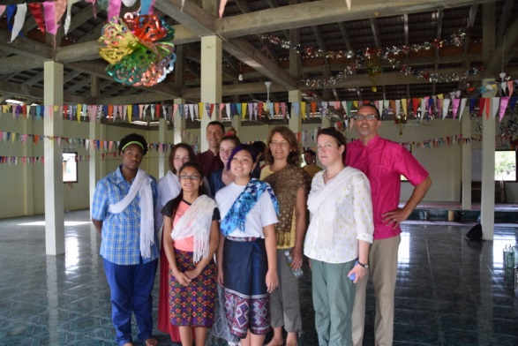
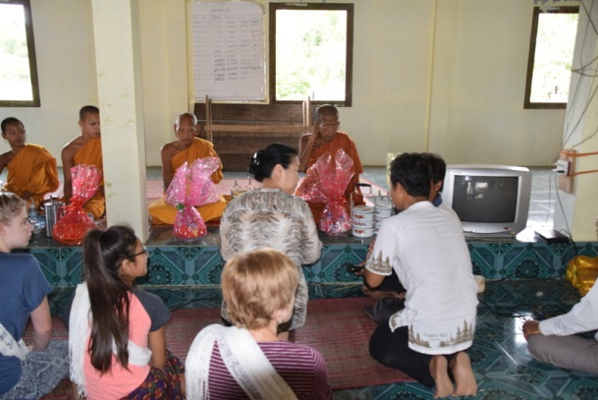
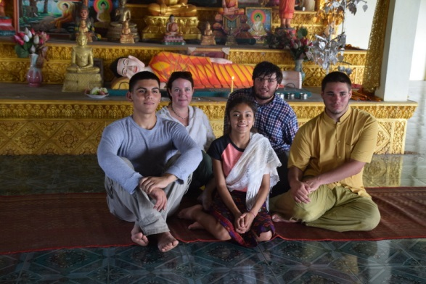
Receiving blessings at the
local pagoda…

Slide 9
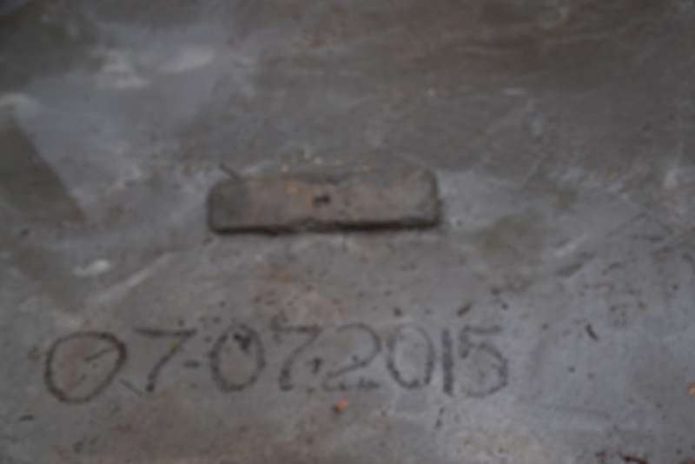
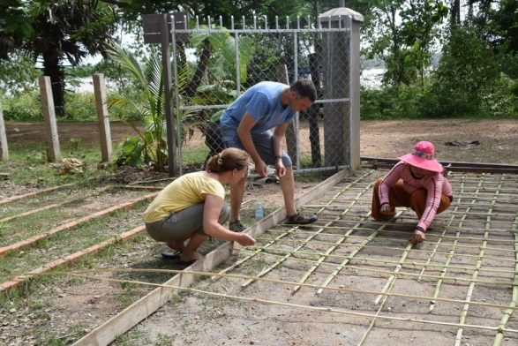
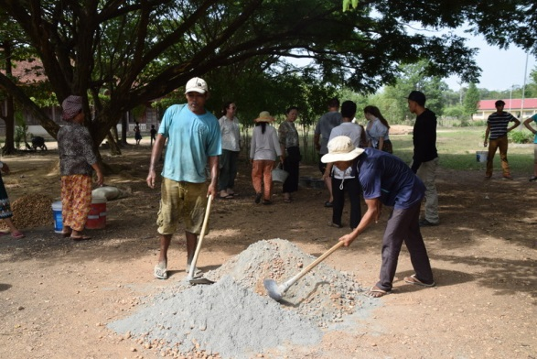
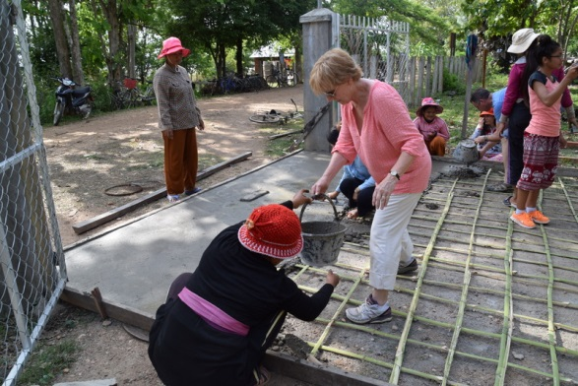
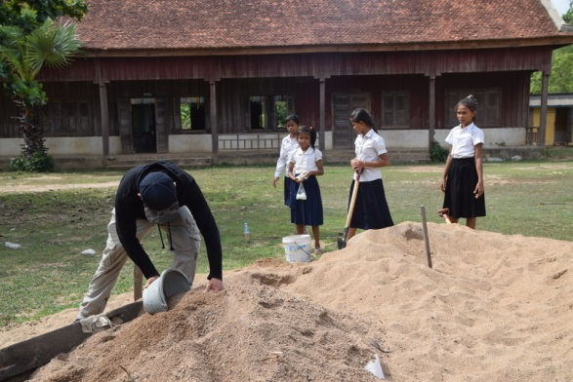
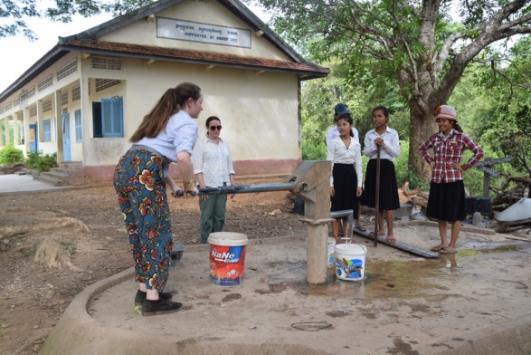
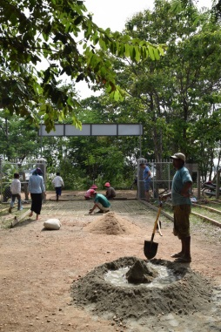
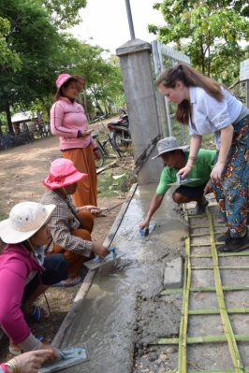
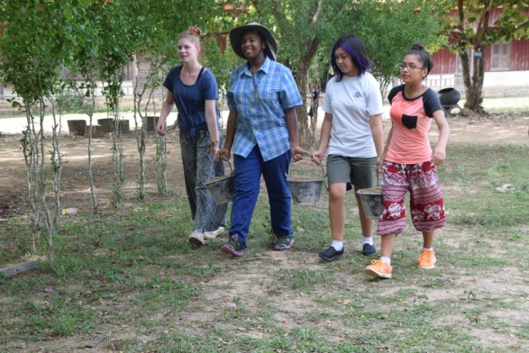
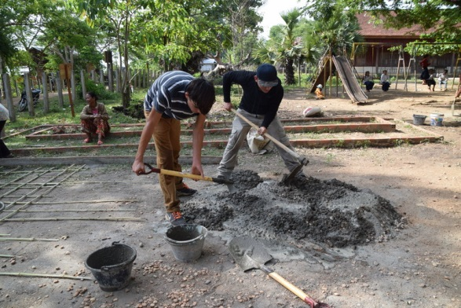
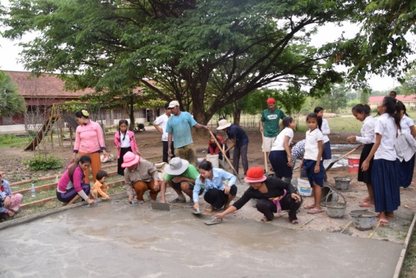
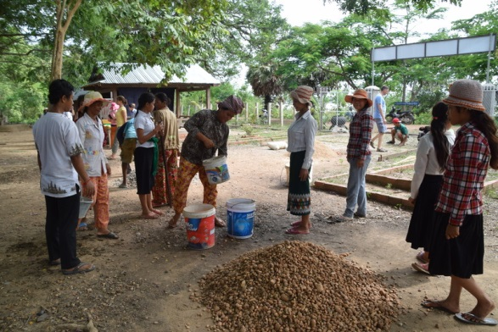
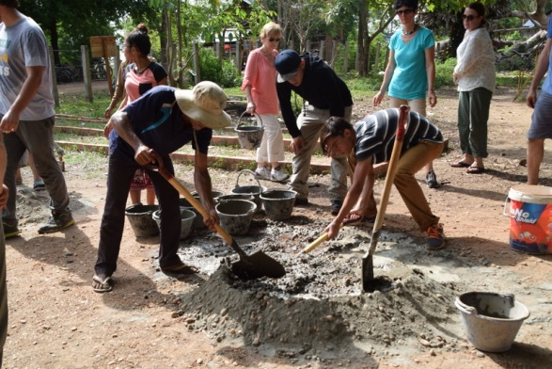
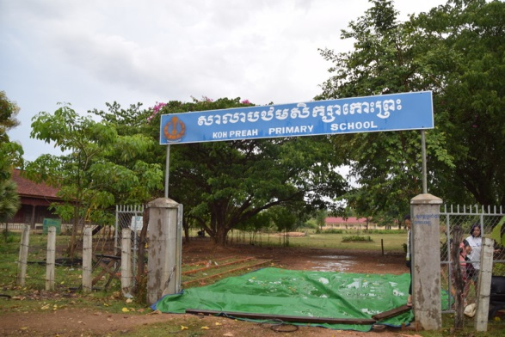
COMMUNITY
SERVICE
PROJECT
2015

Slide 10
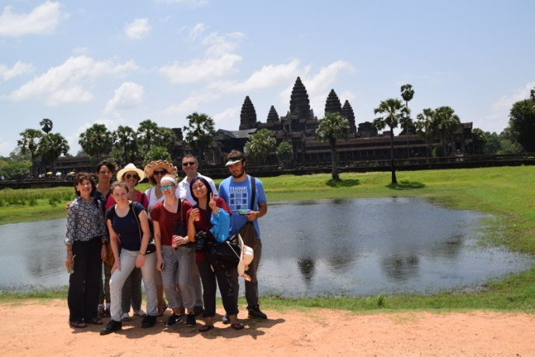
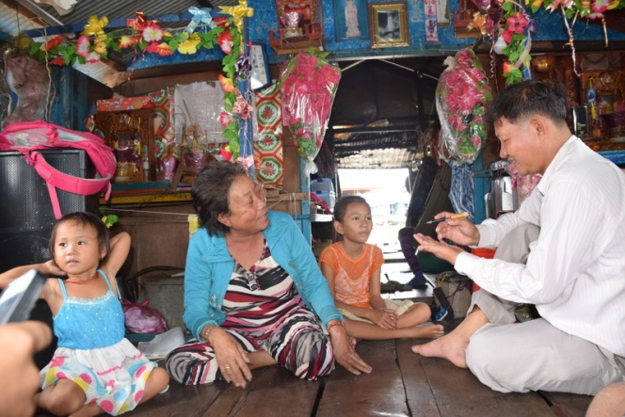
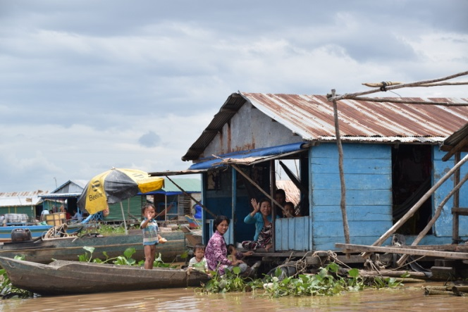
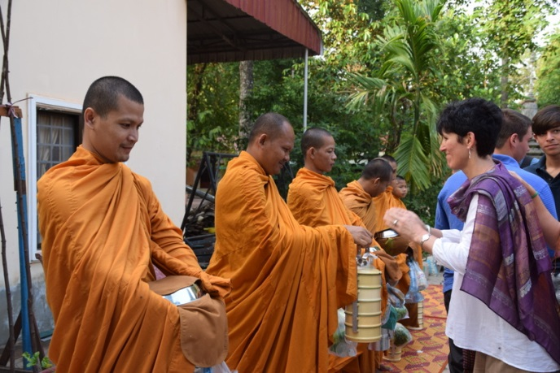
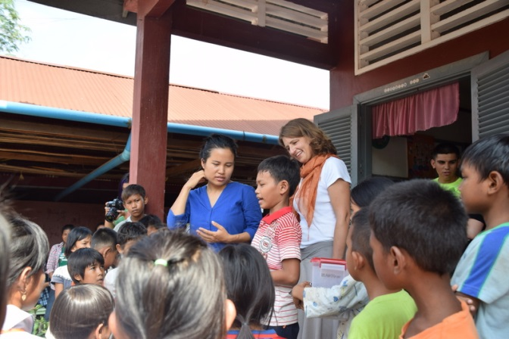
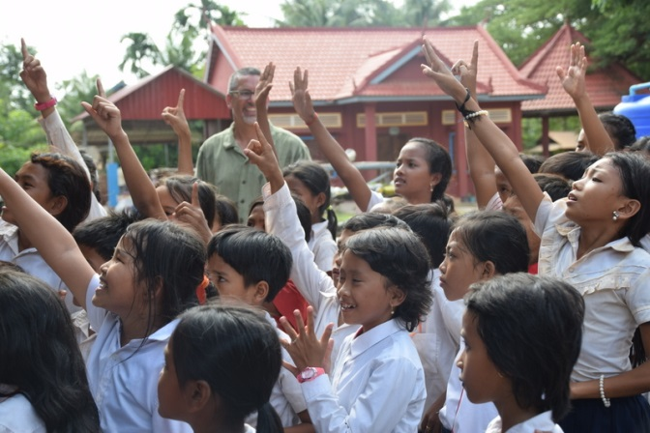
Experiential Learning ...
… in Seim Reap!

Slide 11
Farewell Dinner with PACE students – Siem Reap

Slide 12
Participanting Schools 2015
Students :
Bradley Cochez Scarsdale High School Scarsdale, NY
Kallen Cohane Scarsdale High School Scarsdale, NY
Skyler Lewis Scarsdale High School Scarsdale, NY
Cameron McCartney Furr High School Houston, TX
Shala McKee Pacific Buddhist Academy Honolulu, HA
Jacob Morales Furr High School Houston, TX
Flor Ruvalcaba Furr High School Houston, TX
Julien Ruzzo Awty International School Houston, TX
Talissa Wright Pacific Buddhist Academy Houston, TX
Teachers/Administrators:
David Chason Ardsley High School Ardsley, NY
Sheilah Chason Scarsdale High School Scarsdale,NY
Sylvie Corten Scarsdale High School Scarsdale, NY
Gwen Johnson Scarsdale High School Scarsdale,NY
John Neering Scarsdale High School Scarsdale, NY
Sue Peppers Scarsdale High School Scarsdale, NY
Tiphaine Shaw Furr High School Houston, TX

